Slide 1

Role of the Board in the Current Economy
By: Mike Moyes of CUcorp-HRN

Slide 2
        Presented by:
        Mike Moyes
        CUcorp/HRN
        mike.moyes@cucorp.com
        February 20th, 2010

Slide 3

Introduction
Director- Center for Board Excellence
Board Governance Consulting
Strategic Planning Consulting
ROA and Capital Improvement
Field of Membership Expansion

Slide 4

Background- since 1980’s
Vice President-CFO of $300 Million Credit Union
Director of Consulting- Utah League of CU’s
President/CEO- $265 Million Credit Union
SVP of Operations- $2.8 Billion Credit Union
Board Member for CUES & Community College

Slide 5
Agenda
Environmental Scan
Who are Board Members?
Board Job Description
Key Performance Indicators for 2010
Enhancing Board Satisfaction
6. Better Board Governance

Slide 6
1. Environmental Scan- Current Economy
It’s being called the “Great Recession” and most credit union leaders have never encountered anything like it.

Slide 7

The Economy
Primary effects of the economy on CUs:
Increased delinquency
Increased bankruptcy and charge-offs
Increased foreclosures
Slower loan growth
Shrinking margins
Many opportunities exist
"Thanks to the bold and decisive action we have taken, I can stand here with confidence and say that we have pulled this economy back from the brink,"
"We are by no means out of the woods. A full and vibrant recovery is still many months away."
- President Obama

Slide 8
U.S. Unemployment & Recession
U.S. = 9.7 percent in
Jan 2010
MI = 14.6 percent
Full Employment 5%
Source: U.S. Department of Labor

Slide 9
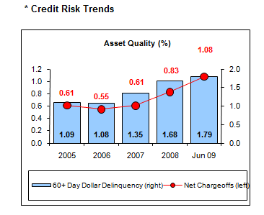
Michigan CU
Delinquency

Slide 10
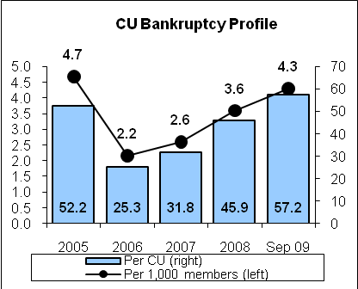
Michigan CU Bankruptcy

Slide 11
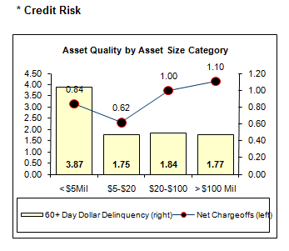
Michigan CU Charge-offs

Slide 12
U.S. Credit Union Loan Growth
Recession
Basis points
est.
Source: CUNA economics & statistics

Slide 13

U.S. Economic Forecast
Economic Forecast 5 Yr Avg 2008 2009 2010
Economic growth (% change in GDP) 2.6% 1.1% -2.0% 2.0%
Inflation (% change in CPI) 2.7 -0.1 0.5 2.0
Core inflation 2.2 1.7 0.5 1.5
Unemployment rate average 5.1 5.8 8.9 10.5
Fed funds rate average 3.30 1.94 0.13 0.50
10-Year Treasury rate average 4.33% 3.68% 2.94% 3.50%
* MI Unemployment is 15% - Detroit is 29%

Slide 14
U.S. CU Outlook
Credit Union Outlook 5 Yr Avg 2008 2009 2010
Savings growth 4.8% 6.9% 12% 10.0%
Loan growth 8.5 6.7 6.0 8.0
Asset growth 6.8 7.2 12.0 10.0
Membership growth 2.3 1.6 3.0 2.0
Loan-to-share ratio 77.6 83.2 78.5 77.0
Delinquency rate 0.87 1.37 1.78 1.50
Net charge-off rate 0.57 0.84 1.28 1.50
Return on average assets (ROA) 0.71 0.31 0.40 0.50
Net-worth ratio 11.2% 10.8% 9.9% 9.5%
MI (2010)
8.6%
5.8
8.7
0.2
72.1
1.79
1.08
0.33
11.1%

Slide 15
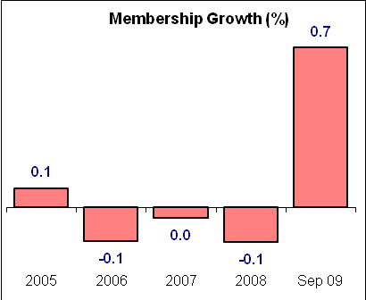
Michigan CU
Membership Growth
Growth from 9-30-08 to 9-30-09

Slide 16
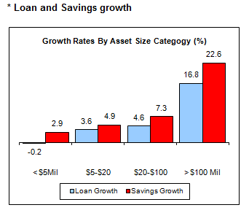
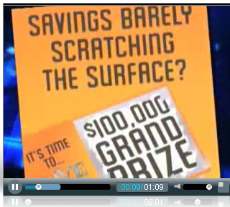
MI CU Growth from 9-30-08 to 9-30-09

Slide 17
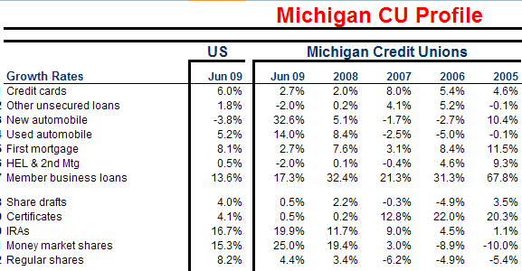
Source: CUNA economics & statistics

Slide 18
CU Share of Mortgage Originations
And Outstandings
Source: Federal Reserve, Mortgage Bankers Association
of America, CUNA, and NCUA

Slide 19
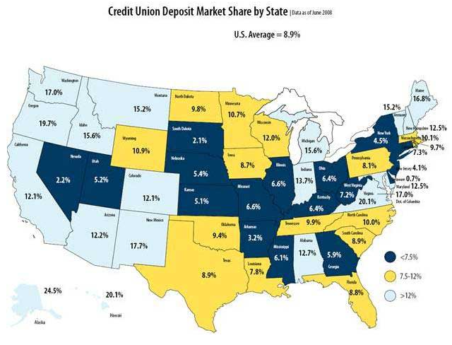

Slide 20
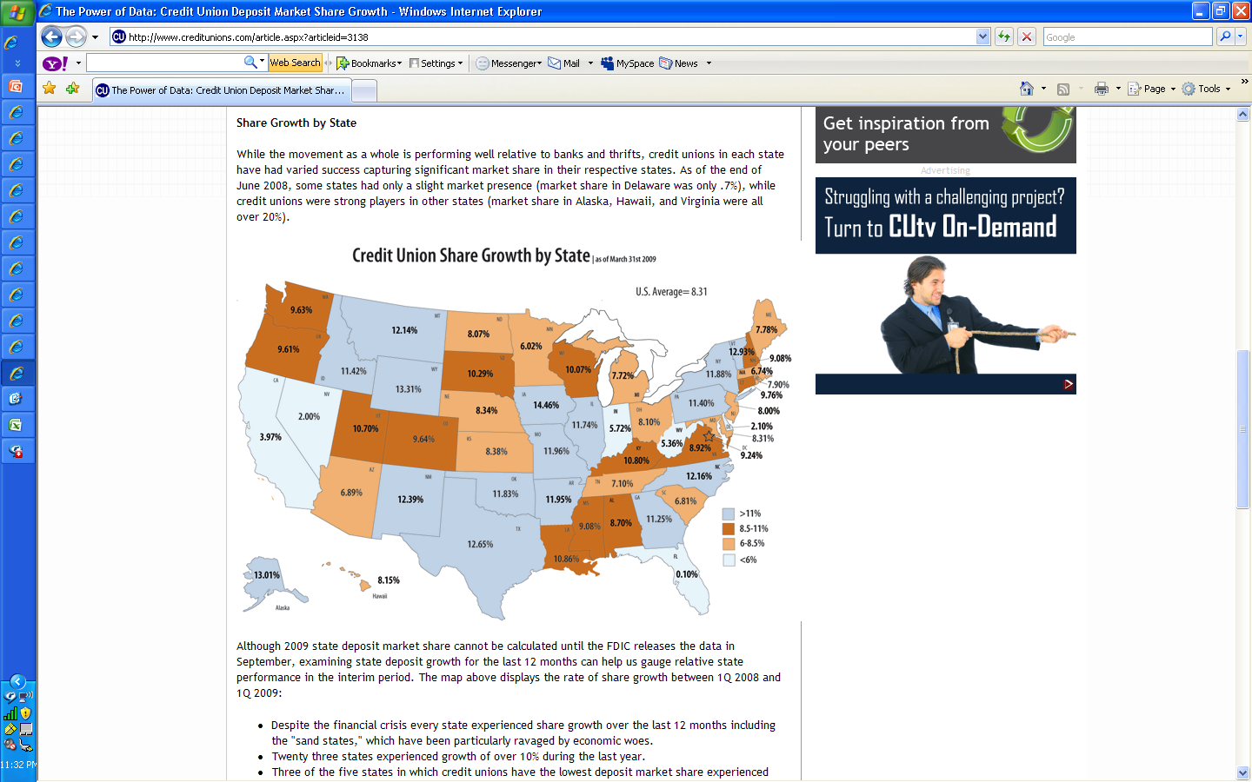

Slide 21
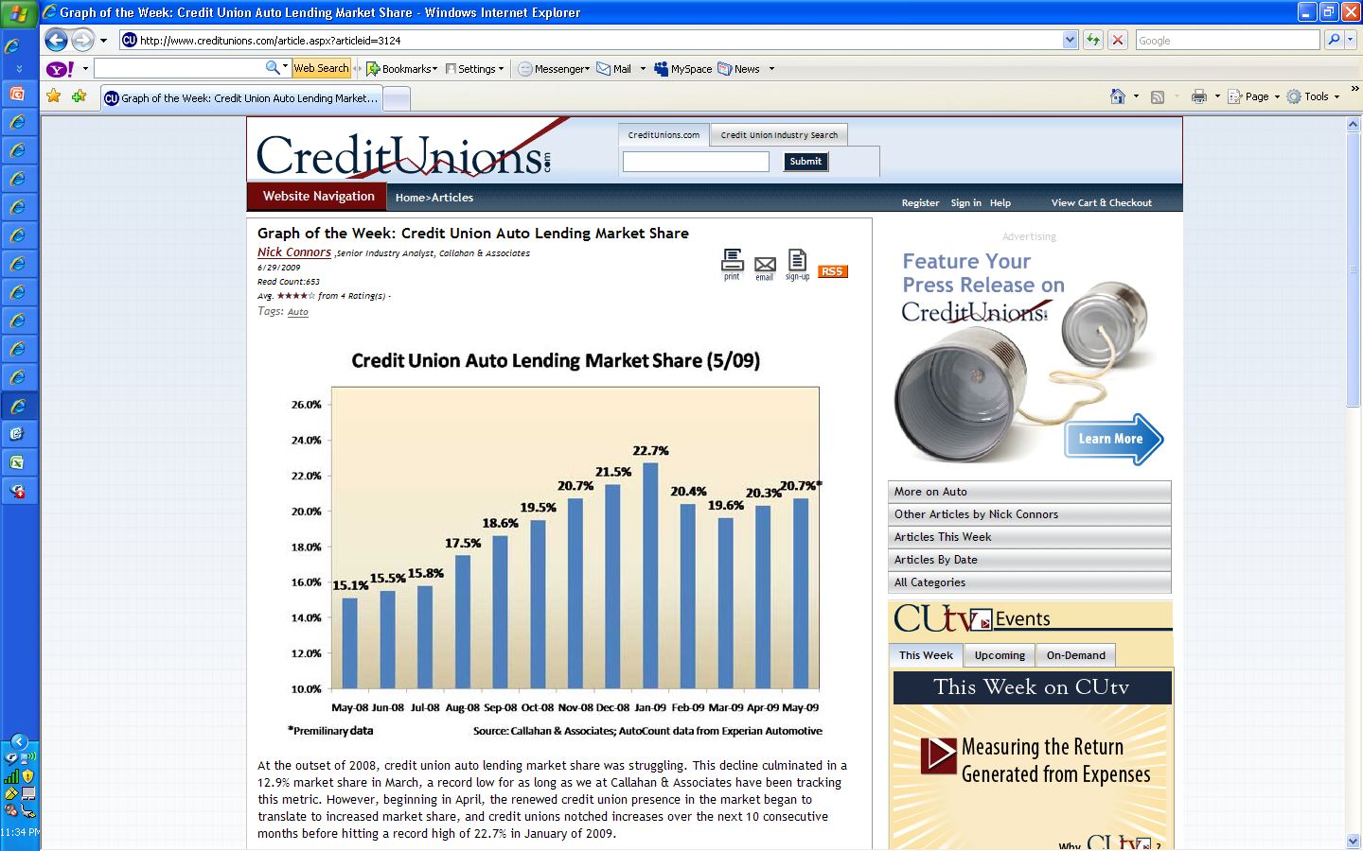
Michigan data: 23% with 2nd largest increase of any state

Slide 22

Controlling Costs and Improving Earnings
Key Considerations:
Fee Income
ALM Strategies
Risk Management
Controlling Costs

Slide 23
CU Return on Assets
Recession
est.
Source: CUNA economics & statistics

Slide 24
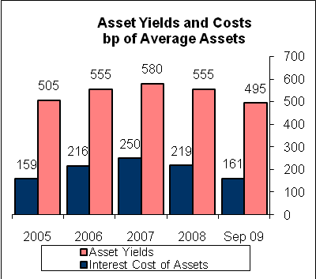
Michigan CU
Asset Yields and Funding Costs

Slide 25
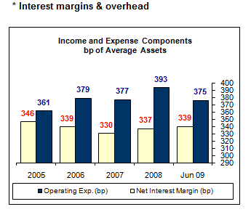
Michigan CU
Interest Margins and Overhead

Slide 26
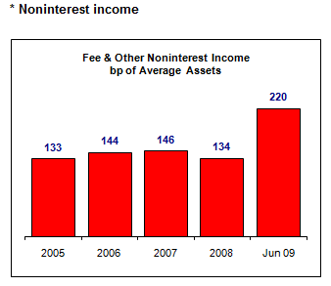
Michigan CU
Non-interest
Income

Slide 27
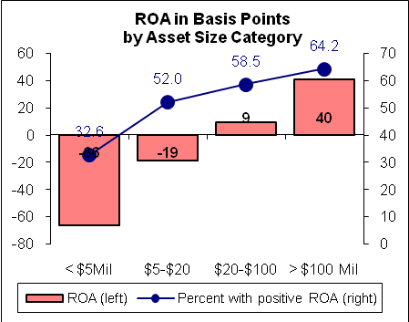
Michigan CU
ROA by Assets

Slide 28
Economic Highlights
Michigan Data
Expect credit union return on assets to rise to 50 basis points in 2010—excluding any National Credit Union Administration corporate bailout charges—from 40bp in 2009 and the record low 31bp in 2008.
Credit unions’ net capital-to-asset ratio will decline to 9.5% in 2010—the lowest level since 1993—as capital contributions fail to keep pace with asset growth.

Slide 29
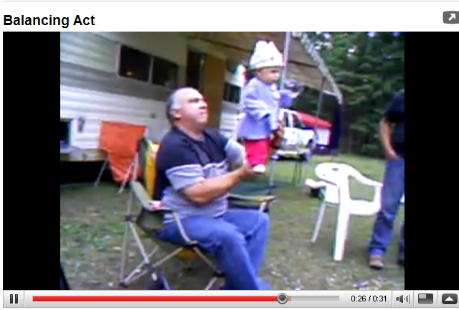
Financial Balancing Act
Don’t let conservatism trump opportunity to serve in this economy. But make sure you survive in the process.
Try to maintain your Net Worth Capital Ratio.
Don’t let deposit growth outpace ROA/Capital Ratios.
Improve loan growth and loan to share ratios by lending to current members and new members.
Watch Spread Analysis closely.

Slide 30
How does the CU make money?
Spread Analysis
  +Yield on Loans
  +Yield on Investments
  Cost of Funds on Member Deposits
  = Gross Spread (Margin)

Slide 31
How does the CU make money?
Spread Analysis
  +Gross Spread
  +Fee Income
  Operating Expenses and Allowance for Loan Loss
  = Return on Assets (ROA)

Slide 32
Profitability
Credit unions focus on profitability as interest margins get squeezed
  Traditional revenue generation
    Loans
    Shares
  Expense control
  Fee Income

Slide 33

Pricing Considerations
Pricing strategies
  Marketplace (competition) pricing
  Value pricing for Market Share
  Cost-plus pricing for ROI
  Relationship pricing (Bundling)

Slide 34
Market Segmentation
Based on demographics (common statistical characteristics) the membership can be divided into different market segments, each segment displaying different lifestyle and lifecycle phases. Each segment has a different set of financial service needs.
Toddlers
Fee Based
Depositors
Young Adults
Credit Driven
Affluent

Slide 35
Whom Do We Serve?
Who is our “target market”?
Who do we want…who don’t we want?
What does a profitable member look like?
Where are they?

Slide 36
Making Decisions
membership

Slide 37
Consumer Satisfaction- “Highly Satisfied”
2005 2006 2007 2008
BANK
S&L
CREDIT UNION
54%
53%
79%
59%
69%
75%
54%
55%
63%
58%
59%
73%

Slide 38
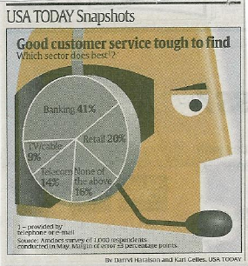
Banking 41%
Retail 20%

Slide 39
Your Competitors
Banks
Internet
Payday Lenders
Investment Firms
Mortgage Lenders
Finance Managers
Other Credit Unions
Banks acting like credit unions!

Slide 40
Changing Demographics
Age 50-plus, fastest growing segment,
Will soon “displace” 14 and under for the first time in our history
Changing notions of:
  Work
  Retirement
  Education
P. Drucker “Next Society”

Slide 41
Changing Demographics

Slide 42
Branding-One Goal
Your brand should serve one purpose – to facilitate your credit union’s strategic direction and purpose (your vision, mission, and values)

Slide 43
What a Brand Is NOT:
A name
A logo
A tagline
Your credit union may already have these, but it doesn’t mean you have a BRAND.

Slide 44

Why is a Brand Important?
Grow us
Guide us
Protect us
Coca-Cola
Emotional bond is power

Slide 45
What is Branding?
Branding will establish the direction and inspiration of your credit union.
Your brand equity will be built on the character, personality, strategic direction, and strength of purpose of the credit union and its products.
The new brand will also help energize you internally, influence member preference and ultimately, strengthen your bottom line.

Slide 46
What is Branding?
As you can see, it is vital that the brand ideology flow through your whole organization. Branding is about how everything is done at your credit union.
Marketing
Processes
Website
Internal Service
As you can tell, branding involves a lot more than just marketing!
Service
Products
Facilities
Training
Pricing

Slide 47






Brand Hall of Fame

Slide 48
Benefits of Building a Brand
A brand builds an emotional bond with your members, as a strong brand is often a consumer’s sole reason for making a purchase; it differentiates one company from all the rest.
A strong brand drives new customers to the business at the same time it keeps current members loyal.
The brand helps attract high-value employees. The best talent expects to work with the best in the business.
A successful brand helps strengthen the bottom line.

Slide 49
2. Who are Board Members?
Volunteer Board Members have been a pillar of the Credit Union movement for 100 years.
More than 61 Million Americans donated their time last year. (U.S. Bureau of Labor)
This totaled 8.1 Billion Volunteer Hours.

Slide 50
2. Who are Board Members?
Michigan and the Midwest region led the country in Volunteer rate at 31.1% of all adults. Congratulations!
There are 107,501 Volunteers serving at Credit Unions as Board and Committee Members.

Slide 51
2. Who are Board Members?
Who are you amazing people?
I commend you for giving of your time.
You build your communities and improve lives.

Slide 52
2. Who are Board Members?
You are “People helping People”.
You play a part in helping young people build their credit with a strong foundation.
You help members get their first car, home, and build their retirement.

Slide 53
2. Who are Board Members?
Credit Union volunteers are extremely loyal and dedicated.
In other industries, 35% of volunteers drop out of service each year.
This greatly inhibits the productivity of the organization they serve.

Slide 54
2. Who are Board Members?
Average number of board members is 7.
For Federally chartered credit unions, Boards may have between 5 and 15 board members.
The board must be comprised of an odd number of members.

Slide 55
3. Board Job Description
Reports to: Members
Works in Partnership with: President/CEO
Primary Function- To set policy, plan the credit union’s course, make sure the credit union maintains its sound financial condition, keep communication open to educate members on services, review the CEO’s progress in achieving goals and objectives, and report to the members at the annual meeting.

Slide 56
3. Board Job Description- Specific Duties
Work with the CEO and board to develop objectives and goals for the credit union.
Ensure the credit union adheres to pertinent laws, regulations, and sound business practices.
Make sure the credit union maintains sound financial conditions and that the credit union’s assets are protected against unauthorized or illegal acts. Authorize borrowing and investing, provide for bonding, approve interest rates and dividends.

Slide 57
3. Board Job Description- Specific Duties
Establish policies, or make sure they are established and then approve them for all credit union programs and activities.
Make sure new services are developed as needed.
Approve the credit union budget.

Slide 58
3. Board Job Description- Specific Duties
Hire the CEO, define the scope of the person’s job and review progress in attaining goals and objectives.
Attend Board meetings, exercise judgment independently from the CEO, and report to the members at the annual meeting.

Slide 59
3. Board Job Description- Responsibilities
Formulating Policies- The board functions as the decision center for Long Term Strategies by establishing objectives, formulating policy and approving goals and programs. Policies, goals and programs determine where the credit union is going.

Slide 60
3. Board Job Description- Responsibilities
Communicating- The board informs its members at the annual meeting about credit union conditions, projects, and changes. Communication between board and management is a two way street. The board should obtain managements input before setting its policies. Constant, open communication is the key!

Slide 61
3. Board Job Description- Responsibilities
Serving as Trustees- The board protects each credit union members’ investments through proper control of the assets. Trusteeship, however, extends beyond the obligation of the board to the members. It also includes an obligation to the public and to the employees.

Slide 62
3. Board Job Description- Responsibilities
Ensuring Development of the Credit Union-
The Board also recruits well-qualified candidates to serve as directors. Also, the board must receive training, review its performance annually and set and accomplish its goals.

Slide 63
3. Board Job Description- Responsibilities
Symbolic Leadership- Directors are leaders in the credit union and regarded as such by the public, the business world and in their communities. Board members must function as a trusted representative for the credit union.

Slide 64
3. Board Job Description- Board/CEO Team
The board of directors receives its power to manage the affairs of the credit union through law and from the members. This doesn’t mean, however, that the board manages the day to day business operations. Directing routine daily operations is delegated to the President/CEO.

Slide 65
3. Board Job Description- Board/CEO Team
This can make it hard to draw an absolute line separating board and executive authority. Both parties are concerned with leadership functions, the difference is in the scope of responsibility.

Slide 66
3. Board Job Description- Board/CEO Team
Board: Idea Decisions:
Give Direction
Determine Objectives
Establish Policies
Approve Goals
Coordinate Directors
Approve Long Range Plans
CEO Succession
Analyze Key Performance
Manage CEO Growth
CEO: Action Decisions:
Direct
Carry Out Objectives
Implement Policies
Propose Goals
Coordinate Operations
Propose Long Range Plans
Employee Succession
Control Key Indicators
Manage Staff Growth

Slide 67
3. Board Job Description- Board/CEO Team
A Study was performed by a highly skilled team of organizational psychologists. They addressed the critical questions involving CEO-Board relationships.
What are the key elements and factors in good and bad CEO-Board relationships?

Slide 68
3. Board Job Description- Board/CEO Team
What are the key elements in good CEO Board relationships?
Trust between the CEO and the Board
Lack of Micromanaging
Clarity of each others Leadership role
Communication

Slide 69
3. Board Job Description- Board/CEO Team
What are the key elements in good CEO Board relationships?
a. Trust between the CEO and the Board
Refers to both parties believing that the other is honest and fully discloses pertinent information. It includes feeling safe to admit mistakes and discuss negative information with each other. It also refers to an open interaction between the board CEO and staff and trusting that the other party will keep agreements and act in the credit unions best interest.

Slide 70
3. Board Job Description- Board/CEO Team
What are the key elements in good CEO Board relationships?
Micromanaging
Micromanaging is the degree to which the board becomes directly involved in operational matters. Examples include communicating directives to the staff, making personnel decisions, or helping to run the credit union on a day to day basis.

Slide 71
3. Board Job Description- Board/CEO Team
What are the key elements in good CEO Board relationships?
Board Role Clarity
Refers to an understanding and knowledge among directors about their working role in a credit union. It also refers to properly differentiating the director’s role from the CEO’s role. In good CEO-board relationships, board roles were clearly understood. In poor relationships, board roles were often ambiguous, unstable and overlapping with the CEO’s role.

Slide 72
3. Board Job Description- Board/CEO Team
What are the key elements in good CEO Board relationships?
d. Communication
Refers to the CEO providing clear, accurate, and proper amounts of information to the board, both positive and negative. It also refers to communicating to the board as equals, keeping the board fully informed, quickly involving the board in issues, and requiring that staff presentations to the board be clear and informative.

Slide 73
4. Key Performance Indicators for 2010
Focus on these Membership Metrics:
New Member Account growth
Closed Member Account/Reason
Membership Mix by Age
Member Survey Results
Employee Turnover

Slide 74
4. Key Performance Indicators for 2010
Transaction Delivery Channel:
32%- Branches
21%- ATM
14%- Direct Deposit/ACH
10%- Home Banking
8%- Audio Response Unit
5%- Mail
5%- Call Center
6%- Other

Slide 75
4. Key Performance Indicators for 2010
Focus on these Brand and Marketing Metrics:
Average # of Services per household
Brand Recognition survey results
Cross-selling success
PFI Relationships- Checking/HELOC Loan
New SEG Development

Slide 76
4. Key Performance Indicators for 2010
Focus on these Branch Metrics:
Loan and Deposit Growth per Branch
Transaction volume per service
ATM usage
Secret Shopper results
Abandoned phone call percentage
Automated loan approvals

Slide 77
4. Key Performance Indicators for 2010
Focus on these Financial Metrics:
Net Interest Margin (Spread Analysis)
Fee Income Ratio
Provision of Loan Loss Ratio
Loan to Share Ratio/ Asset Growth Ratio
ROA/ Net Worth Capital Ratios
Net Economic Value (NEV) Ratio

Slide 78
5. Enhancing Board Satisfaction
A Survey was performed to understand what key factors enhanced Board of Director Satisfaction. This study asked the following questions:
What Board Tasks and Activities are the most important?
2. How should Boards conduct their business (Work Styles)?
3. Which Board Tasks, Activities and Work Styles achieve the best results?

Slide 79
5. Enhancing Board Satisfaction
Board Tasks Options included:
Planning effectiveness
Evaluating effectiveness
Micromanaging
Making policies
Managing CEO accountability
Member service
Community representation
Financial governance

Slide 80
5. Enhancing Board Satisfaction
Board Activities Options included:
Closely monitor the financial soundness of the credit union
Developing the strategic plan to achieve goals
Assessing skills/characteristics of board members
Performing the annual CEO evaluation
Monitoring implementation of strategic plans

Slide 81
5. Enhancing Board Satisfaction
Board Activities Options included: (Continued)
Reviewing favorable and unfavorable environmental conditions
Identifying long range goals for the credit union
Making credit union policies
Forming new strategic decisions
Evaluating previous strategic decisions

Slide 82
5. Enhancing Board Satisfaction
Board Work Style Options included:
Commitment to duty
Board unity
Efficiency
Feedback style
Tolerance
Constructive communication
Risk taking

Slide 83
5. Enhancing Board Satisfaction
How did they measure Credit Union Effectiveness?
Service satisfaction
Public image
Growth
Willingness to improve
Staff morale
Participatory management
Comparison to competitors
CAMEL ratings

Slide 84
5. Enhancing Board Satisfaction
The Study showed the strongest positive relationship between Board Tasks, Activities and Performance with:
Planning and Evaluating Effectiveness-
Reviewing the Strategic Plan, setting clear 3 year goals, being forward thinking, developing clear annual financial plans, considering ethics, setting clear annual member service goals, discussing your Vision, comparing goals vs. accomplishments, and evaluating board effectiveness.

Slide 85
5. Enhancing Board Satisfaction
The Study showed the strongest positive relationship between Board Tasks, Activities and Performance with:
2. Managing CEO Accountability-
Evaluating CEO success, reviewing goals set by board and performance and evaluating CEO compensation.

Slide 86
5. Enhancing Board Satisfaction
The Study showed a positive relationship between Board Tasks, Activities and Credit Union Performance with:
Making and evaluating policies
Member Service
5. Community representation

Slide 87
5. Enhancing Board Satisfaction
The Study showed a neutral relationship between Board Tasks, Activities and Credit Union Credit Union Performance with:
Financial Governance

Slide 88
5. Enhancing Board Satisfaction
The Study showed a negative relationship between Board Tasks, Activities and Credit Union Performance with:
Micromanaging

Slide 89
5. Enhancing Board Satisfaction
The researchers compared Board Work Style behavior Survey results with Credit Union Performance.
The researchers uncovered six general work styles that are positively related to high credit union performance. Three Work Styles had strong positive relationships with success.

Slide 90
5. Enhancing Board Satisfaction
The Study showed the strongest positive relationship between Board Work Styles and high Credit Union performance with:
Board Efficiency-
Making efficient use of time, spending little time on irrelevant issues, focusing quickly on business that needs to be done, having a clear agenda and sticking to it.

Slide 91
5. Enhancing Board Satisfaction
The Study showed the strongest positive relationship between Board Work Styles and high Credit Union performance with:
Risk Taking-
Which includes willingness to take calculated risks when necessary, making difficult decisions, and understanding the relationship between risk and rates of return.

Slide 92
5. Enhancing Board Satisfaction
The Study showed the strongest positive relationship between Board Work Styles and high Credit Union performance with:
Commitment to Duties-
Commitment to job, being energetic about duties, willingly volunteering for committee assignments, being well prepared for board meetings, and meeting often enough to accomplish board tasks.

Slide 93
5. Enhancing Board Satisfaction
The Study showed a positive relationship between Board Work Styles and Credit Union performance with:
Board Unity
Feedback Styles
5. Constructive and Participative Communication

Slide 94
5. Enhancing Board Satisfaction
“Above and Beyond” Ideas for 2010:
Electronic Board Packet
Dashboard
Meet before Board Meeting- Be upfront- No surprises
Spend time together away from the Board Room- Conferences

Slide 95
6. Cutting-Edge Board Governance
In today’s difficult economy, we realize that what worked yesterday, may not work today.
New Paradigms make us continually look to improve and stretch for a competitive advantage.
Many credit unions and other businesses around the world have found greater success and discovered a better, results-driven Governance Model.

Slide 96
6. Cutting-Edge Board Governance
Dr. John Carver’s groundbreaking book, “Boards that Make a Difference”, has revolutionized Board Governance.
This Governance model is being used by some of the largest and most successful credit unions in Michigan and the U.S.
The model has been highlighted at MCUL, CUNA and CUES Conferences & in Credit Union Times & Credit Union Journal.

Slide 97
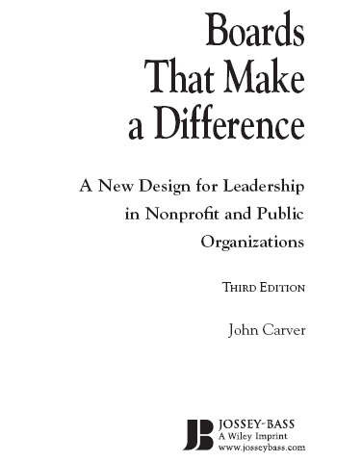

Slide 98
What can be shortfalls of traditional Board Governance?
6. Cutting-Edge Board Governance
Time spent on the trivial
Reading reams of documents
Long-running meetings that accomplish little
Committees that are duplication of what management does
Micromanaging in administration
Unclear boundaries of authority
Complete overload

Slide 99
What can be shortfalls of traditional Board Governance?
6. Cutting-Edge Board Governance
Staff in control of board agendas
Reactivity vs. Proactivity
Executive committee as de facto Board
Confusion about direction and priorities
Rubber stamping
No clear method to evaluate the CEO
Short-term bias

Slide 100
What effect does it have on the Board and CEO?
6. Cutting-Edge Board Governance
Survey’s show that successful and satisfied boards have several things in common:
Focus on Strategic Planning (The Big Picture)
Knowledge of CEO and Board Roles
Detailed Policies
Members Service focus
Community Representation

Slide 101
What effect does it have on the Board and CEO?
6. Cutting-Edge Board Governance
Survey’s show that successful and satisfied boards have several things in common:
Clear Agenda
Communication
Lack of Micromanaging
Common Trust
Focus on Priorities

Slide 102
6. Cutting-Edge Board Governance?
“Reduced to its minimum, the purpose of governance is to ensure, on behalf of members, that a credit union achieves what it should achieve while avoiding those behaviors and situations that should be avoided.”

Slide 103
What is the Carver Board Governance Model?
6. Cutting-Edge Board Governance
The Model is a theory and set of practices for all non-profit boards.
It allows you to enhance your ability to set direction for the credit union.
Policies are re-written detailing the Board and the CEO’s role and responsibilities.
The Policies can written in great detail or less detail depending on your credit union’s culture.

Slide 104
What is the Carver Board Governance Model?
6. Cutting-Edge Board Governance
It allows the Board and CEO to focus on the purpose of the credit union.
Your credit union was organized by the members for their benefit.
The Model allows you to focus more on how members will be served and what benefits they will receive.

Slide 105
What are the benefits of Carver Board Governance?
6. Cutting-Edge Board Governance
Boards can be “forward-thinking”
Helps the Board and CEO avoid lawsuits
Focusing on Results: The Power of Purpose
Boards focus more on Key Issues and Institutionalizing Excellence
It makes meetings more meaningful by spending time creating the future more than reviewing the past

Slide 106
What are the benefits of Carver Board Governance?
6. Cutting-Edge Board Governance
Board Governance requires that the board provide Vision. To do so, the board must first have an adequate Vision of its own job.
Governance is an approach to the job of governing that emphasizes values.
It allows for the empowerment of both the Board and the CEO.

Slide 107
What types of Governance Policies are written?
6. Cutting-Edge Board Governance
Observing the principles of the Governance Model, a board crafts its values into policies of four types including:
Ends Policies
Executive Guidance and Limitations
Board- CEO Delegation
Governance Process

Slide 108
What types of Policies are written?
6. Cutting-Edge Board Governance
1. Ends Policies:
The Board defines which member needs are to be met, for whom, and at what worth. Written with a long term perspective, these policies embody most of the board’s part of long range strategic planning.

Slide 109
What types of Policies are written?
6. Cutting-Edge Board Governance
2. Executive Guidance and Limitations Policies:
The Board and CEO establish the boundaries of acceptability within which the CEO and management team operates.

Slide 110
What types of Policies are written?
6. Cutting-Edge Board Governance
3. Board-Management Delegation Policies:
The board clarifies the manner in which it delegates authority to the CEO as well as how it evaluates CEO and staff performance.

Slide 111
What types of Policies are written?
6. Cutting-Edge Board Governance
4. Governance Process Policies:
The board clarifies its philosophy, its accountability, and specifics for its own job as the governing body of the credit union.

Slide 112
Does your Credit Union need this?
6. Cutting-Edge Board Governance
Carver model is for the best of today’s boards, not just for struggling ones.
Why is it relevant to today’s credit unions?
It makes good credit unions great and great credit unions even better.
It allows you to produce what Members want from their credit union.

Slide 113
Callahan on the Carver Board Governance Model:
6. Cutting-Edge Board Governance
Chip Filson, CEO of Callahan and Associates on Carver Board Governance:
“ As credit unions move away from their historical field of memberships to broader community charters, boards can be key contributors connecting with new SEGS and Members. Most importantly the board can help management focus on the best long-term strategic priorities.”

Slide 114
How do I take advantage of Carver Board Governance?
6. Cutting-Edge Board Governance
Learning and Preparation phase
Make the decision to improve and succeed
Set a date for Governance retreat & meeting
Prepare Policies
Start using Governance with a “Blitz” meeting
Refine and improve as needed
Enjoy the benefits of improved Governance!

Slide 115
Role of the Board in the Current Economy
By: Mike Moyes of CUcorp-HRN

Slide 116
Thank You!
Director- Center for Board Governance
Board Governance Consulting
Strategic Planning Consulting
ROA and Capital Improvement
Field of Membership Expansion

Slide 117
        Presented by:
        Mike Moyes
        CUcorp/HRN
        mike.moyes@cucorp.com
        734-793-1530 ext. 520

